Slide 1


Slide 2


ABOUT ME
Naresh Dulam
Dad, Husband, Career Guide
Data + AI/ML Cloud Leader
15 Years Expertise in building Enterprise Data Application
Worked at Oracle, Bank Of America, AT&T.
Education:
Certified
Bachelors of Technology in Computer Science & Technology, India
2XAWS, 1XSnowflake, 3XKubernetes

Slide 3
Improving Real-World RAG Systems
Key Challenges & Practical Solutions

Slide 4
Understanding RAG Systems
Notes:
See you in the next lesson.

Slide 5






















What is a RAG System?
APIs
Response
Raw Files
User
Vector Stores
Query
Databases
Notes:
The external knowledge base could be-Data from APIs like Slack channel, Discord, Notion, Sales force CRMorRaw files like PDF, PPT, Audio, VideoorVector DBs like Pinecone, Weaviate, Qdrant, Opensearch orSQL Databases

Slide 6
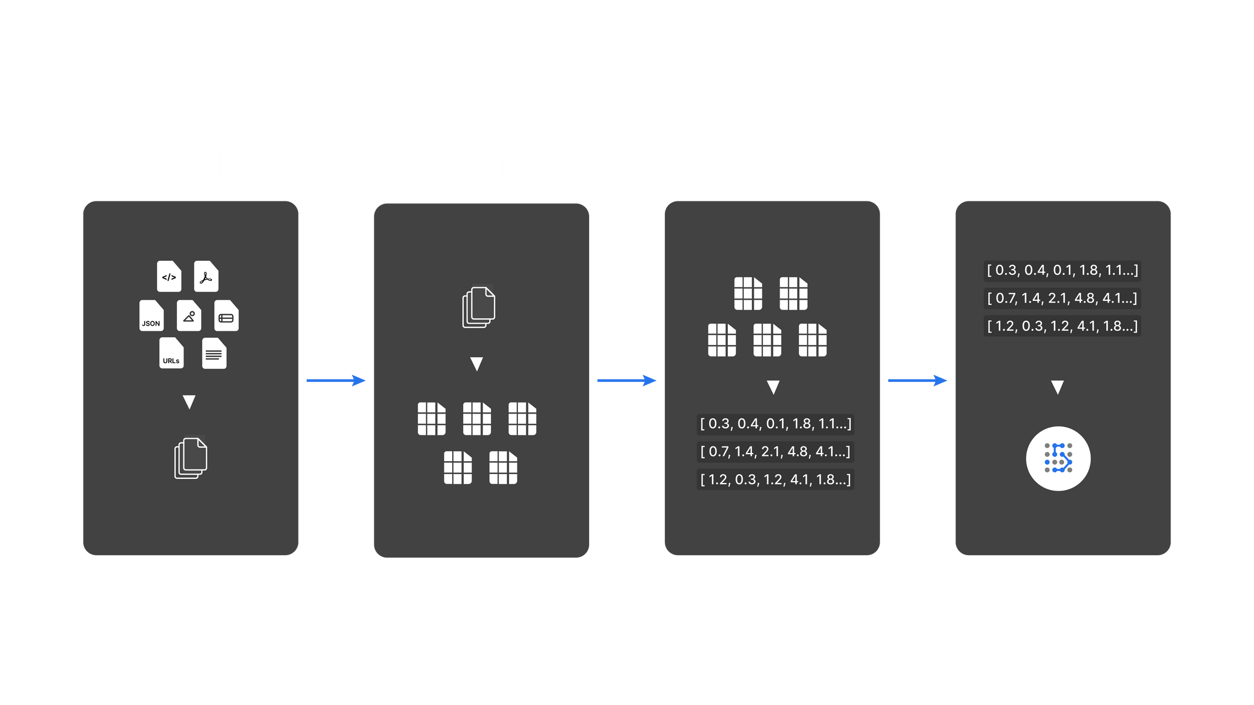
RAG System Architecture - Data Indexing
Notes:
Today, instruction following llms like chatgpt, bard, and Claude are used by individuals of all age groups, for both personal and business purposes.

Slide 7
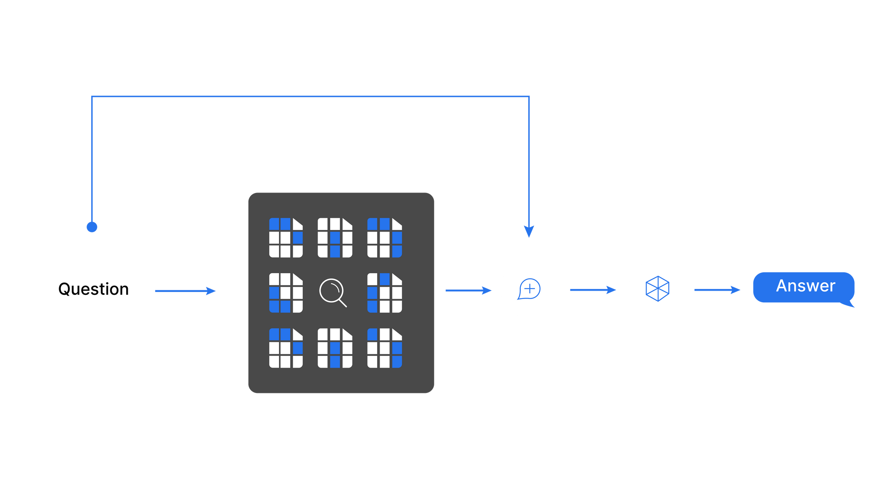
RAG System Architecture - Search and Generation
Notes:
Today, instruction following llms like chatgpt, bard, and Claude are used by individuals of all age groups, for both personal and business purposes.

Slide 8
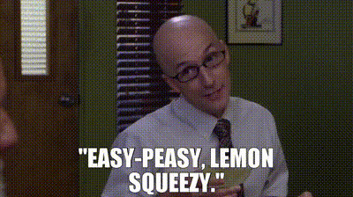
Notes:
Source https://getyarn.io/yarn-clip/226bc75f-e027-4b50-9143-35e262d19f97/embed?autoplay=false&responsive=true

Slide 9
RAG System Challenges & Practical Solutions
Notes:
See you in the next lesson.

Slide 10
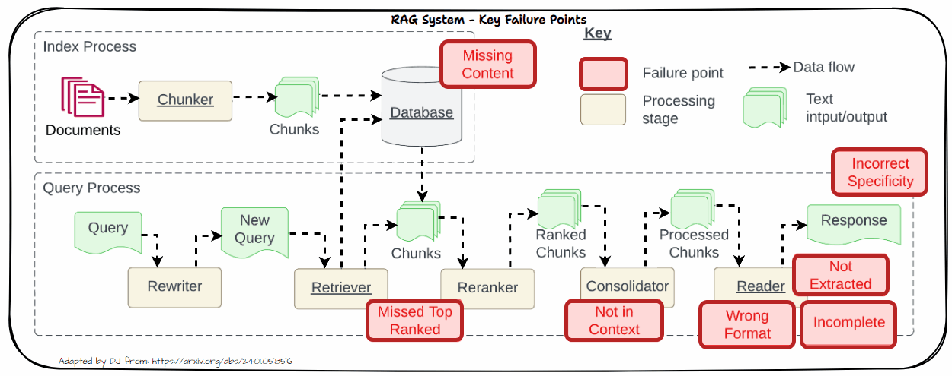
Key Failure or Pain Points in a RAG System
Source: Seven Failure Points When Engineering a Retrieval Augmented Generation System
Notes:
Today, instruction following llms like chatgpt, bard, and Claude are used by individuals of all age groups, for both personal and business purposes.

Slide 11
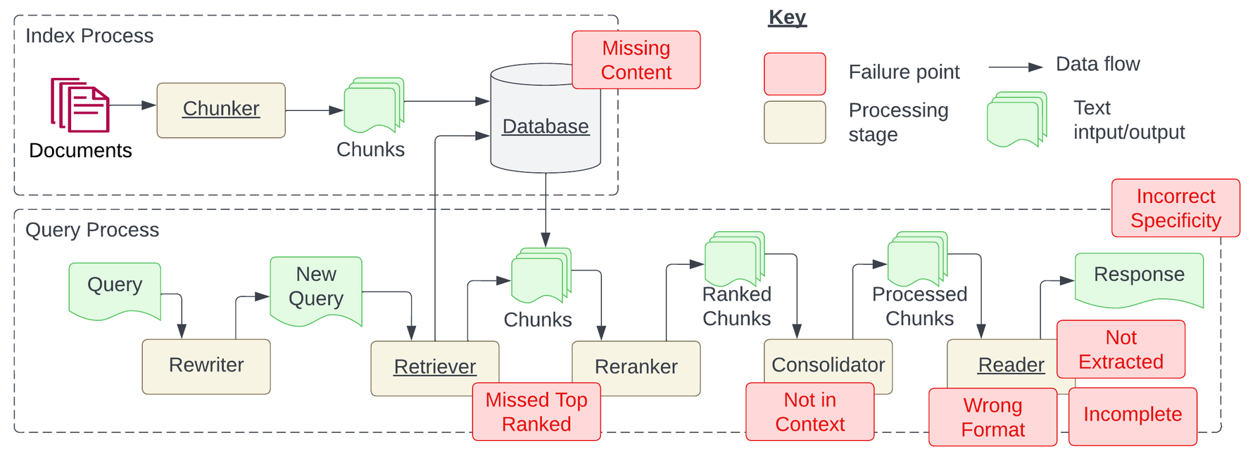
Problem: Missing Content
Missing Content means the relevant context to answer the question is not present in the database
Leads to the model giving a wrong answer and hallucinating
End users end up being frustrated with irrelevant or wrong responses
Source: Seven Failure Points When Engineering a Retrieval Augmented Generation System

Slide 12



Solutions for Missing Content
Better data cleaning using tools like unstructured.io to ensure we extract good quality data
Better prompting to constrain the model to NOT answer the question if the context is irrelevant
Agentic RAG with search tools to get live information for question with no context data
Source: Seven Failure Points When Engineering a Retrieval Augmented Generation System

Slide 13
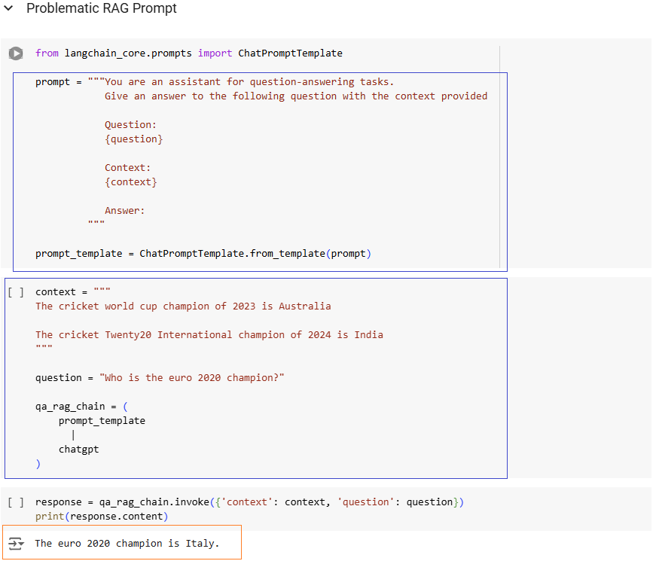

Slide 14
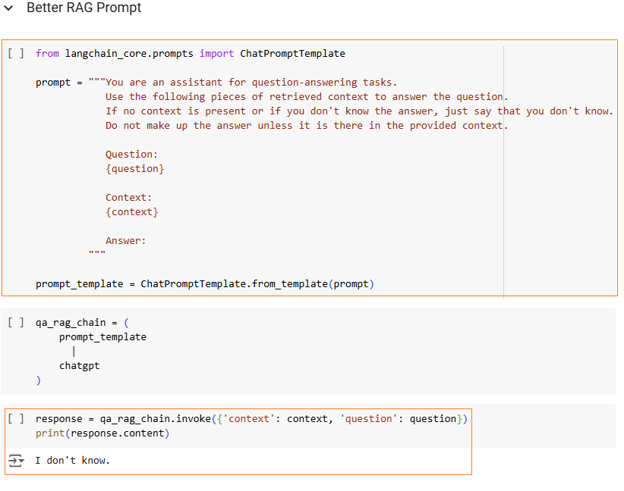

Slide 15
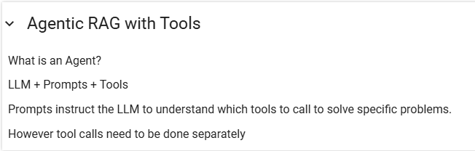
Agentic RAG with Tools

Slide 16
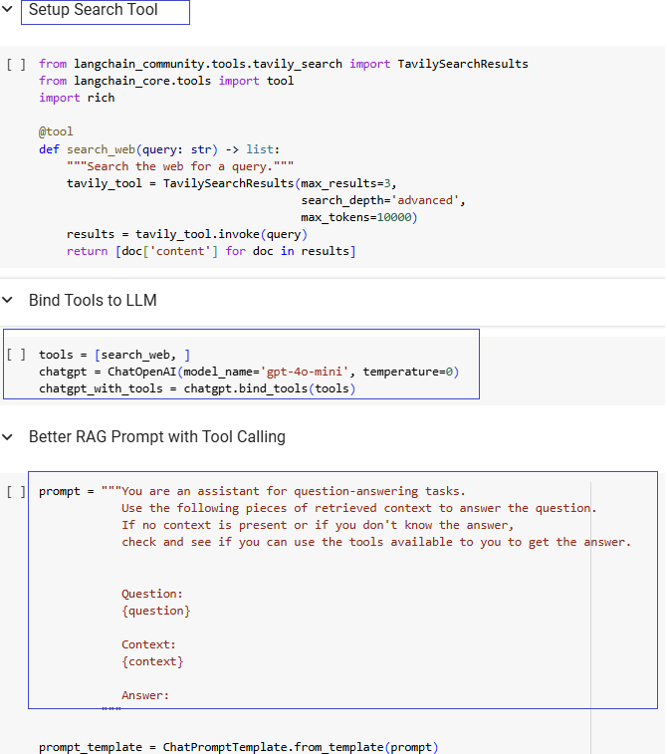
Agentic RAG with Tools

Slide 17
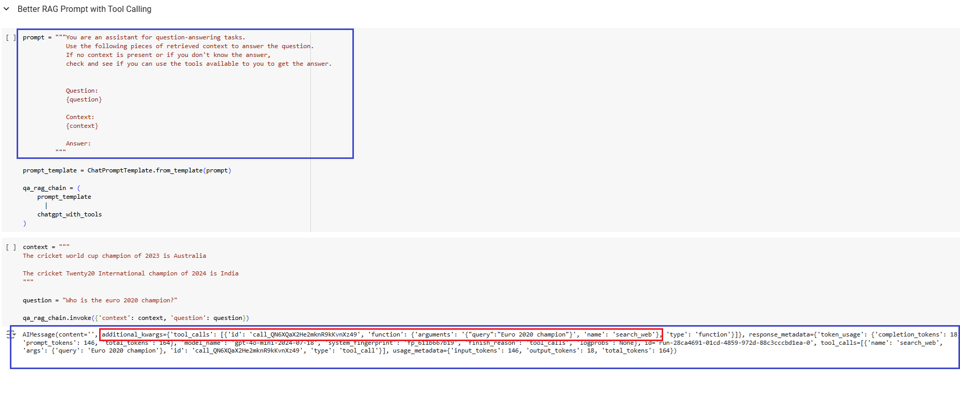
Agentic RAG with Tools

Slide 18
Problem: Missed Top Ranked
Missed Top Ranked means context documents don’t appear in the top retrieval results
Leads to the model not able to answer the question
Documents to answer the question are present but failed to get retrieved due to poor retrieval strategy
Source: Seven Failure Points When Engineering a Retrieval Augmented Generation System

Slide 19
Problem: Not in Context
Not in Context means documents with the answer are present during initial retrieval but did not make it into the final context for generating an answer
Bad retrieval, reranking and consolidation strategies lead to missing out on the right documents in context
Source: Seven Failure Points When Engineering a Retrieval Augmented Generation System

Slide 20
Problem: Not Extracted
Not extracted means the LLM struggles to extract the correct answer from the provided context even if it has the answer
This occurs when there is too much unnecessary information, noise or contradicting information in the context
Source: Seven Failure Points When Engineering a Retrieval Augmented Generation System

Slide 21
Problem: Incorrect Specificity
Output response is too vague and is not detailed or specific enough
Vague or generic queries might lead to not getting the right context and response
Wrong chunking or bad retrieval can lead to this problem
Source: Seven Failure Points When Engineering a Retrieval Augmented Generation System

Slide 22
Use Better Chunking Strategies
Hyperparameter Tuning - Chunking & Retrieval
Use Better Embedder Models
Use Advanced Retrieval Strategies
Use Context Compression Strategies
Use Better Reranker Models
Solutions for Missed Top Ranked, Not in Context & Incorrect Specificity
Source: Seven Failure Points When Engineering a Retrieval Augmented Generation System
Notes:
Various base llms have been developed since the launch of chatgpt by<Click> training on different domain specific datasets, <Click>experimenting with different model architectures, <Click>and scaling the size of the llms, and so on.

Slide 23
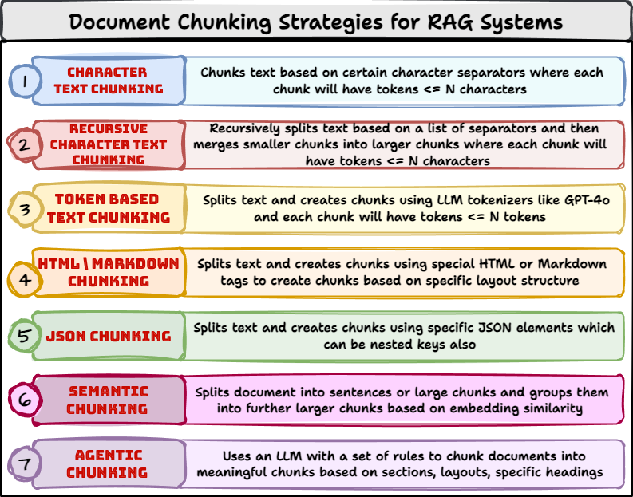
Experiment with Various Chunking Strategies

Slide 24








Hyperparameter Tuning - Chunking & Retrieval
Generate Answer
LLM
Context: -----------
Question: ----------- Answer -----------
Chunk Size = C
Top_K=K Sim_thresh = S
Eval Metrics
Vector DB
C Value Space
K Value Space
S Value Space
500
5
0.2
1,000
8
0.3
2,000
10
0.5

Slide 25
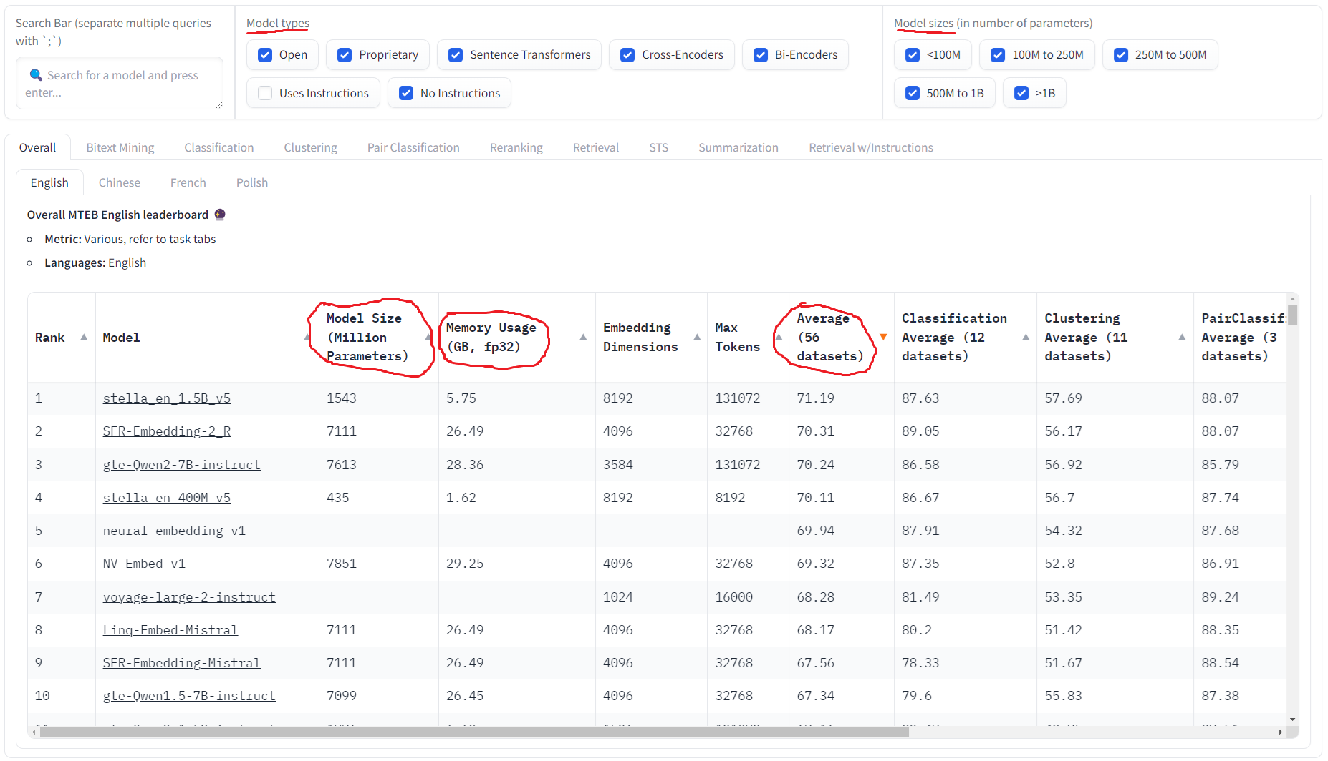
Better Embedder Models - MTEB Leaderboard

Slide 26
Better Embedder Models - Experiment Yourself
hello world
Embedding models
-0.027
-0.001
-0.020
.......
-0.023
Text
Text as vector
Newer Embedder Models will be trained on more data and often better
Don’t just go by benchmarks, use and experiment on your data
Do not use commercial models if data privacy is important

Slide 27
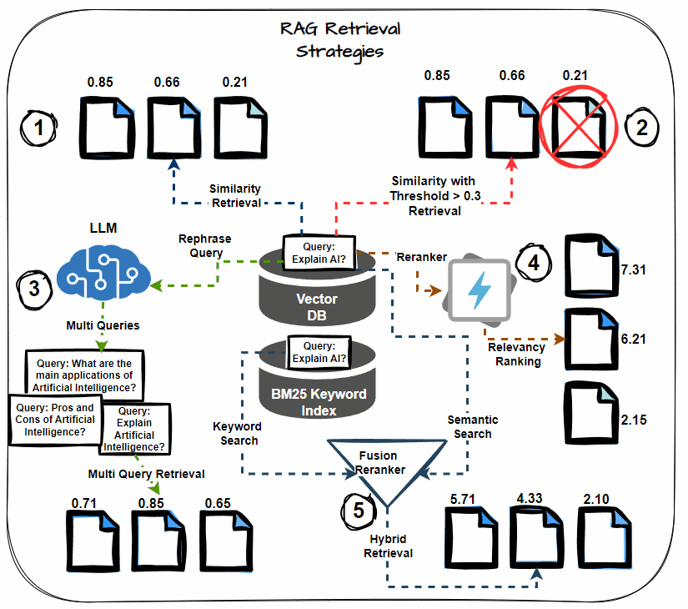
Advanced Retrieval Strategies
Semantic Similarity Thresholding
Multi-query Retrieval
Hybrid Search (Keyword + Semantic)
Reranking
Chained Retrieval

Slide 28
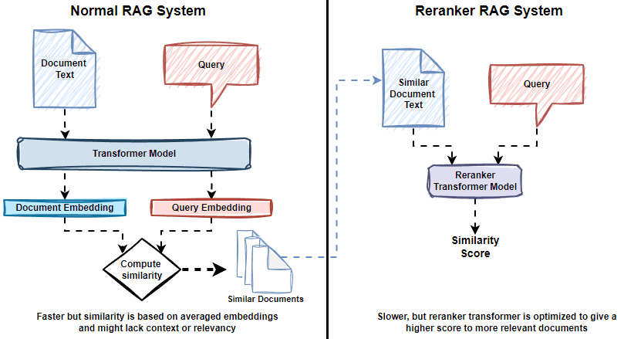
Better Reranker Models
Rerankers are fine-tuned cross-encoder transformer models
These models take in a pair of documents (Query, Document) and return back a relevance score
Models fine-tuned on more pairs and released recently will usually be better

Slide 29
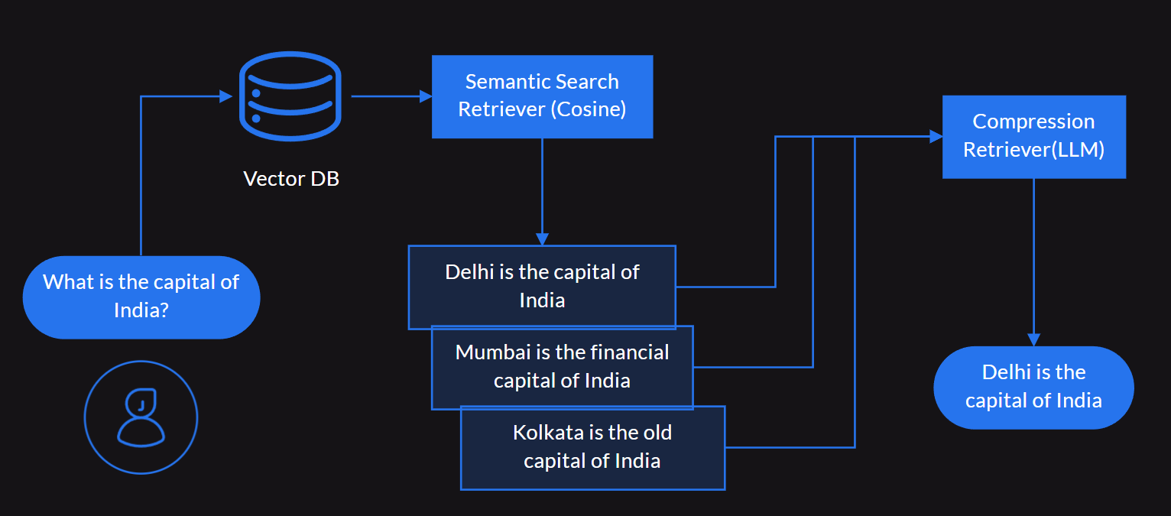
Context Compression Strategies
LLM prompt-based Context Compression
Extractor: Filters out content from context document not related to query
Filter: Filters out whole context documents not related to query
Microsoft LLMLingua Prompt Compression

Slide 30
Problem: Wrong Format
The output response is in the wrong format
It happens when you tell the LLM to return the response in a specific format e.g JSON and it fails to do so
Source: Seven Failure Points When Engineering a Retrieval Augmented Generation System

Slide 31


Solutions for Wrong Format
Powerful LLMs have native support for response formats e.g OpenAI supports JSON outputs
Better Prompting and Output Parsers
Structured Output Frameworks
Source: Seven Failure Points When Engineering a Retrieval Augmented Generation System

Slide 32
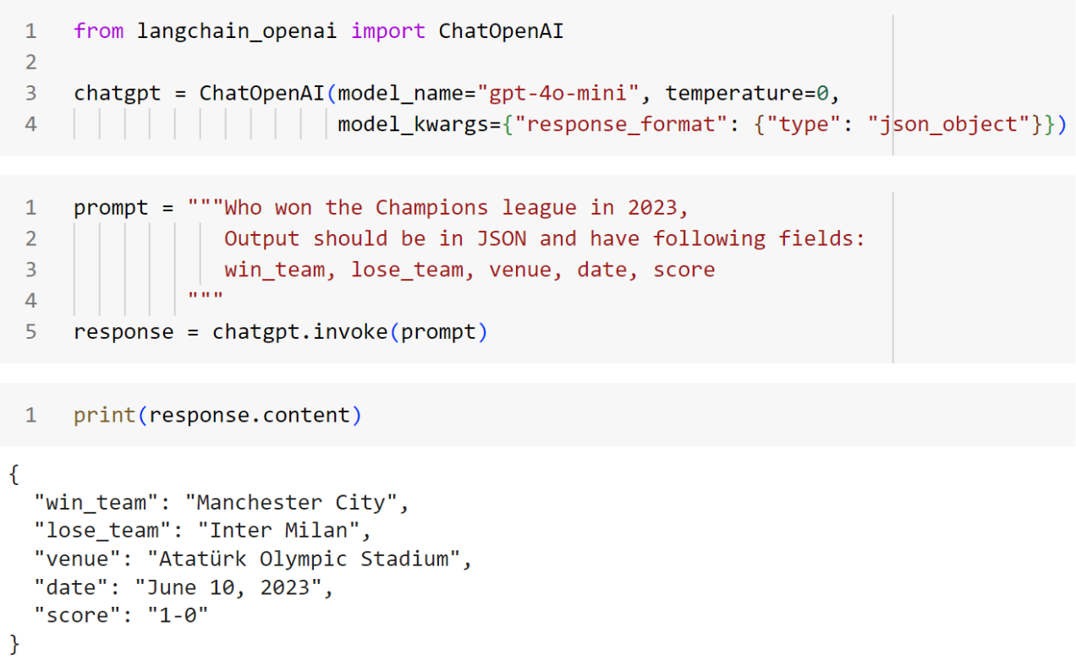
Solutions for Wrong Format - Native LLM Support
Notes:
Today, instruction following llms like chatgpt, bard, and Claude are used by individuals of all age groups, for both personal and business purposes.

Slide 33
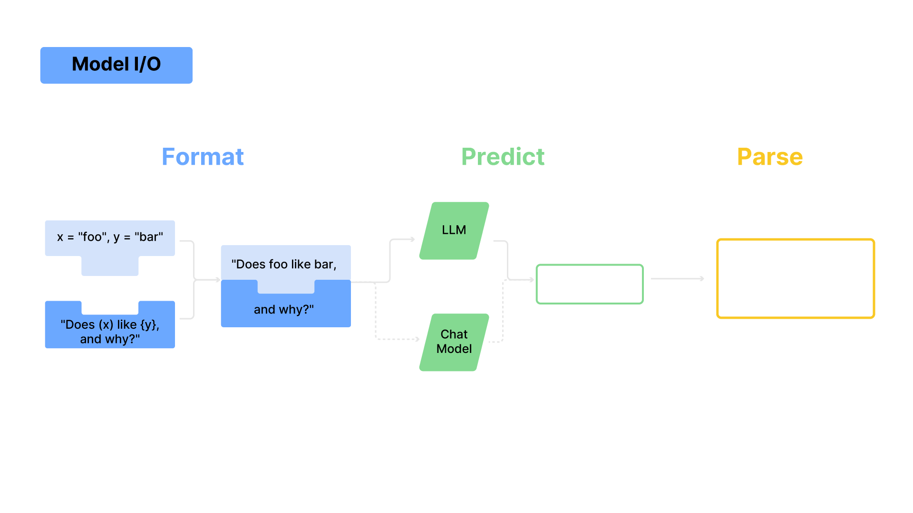

Solutions for Wrong Format - Output Parsers & Better Prompting
Tools like LangChain allows to convert the raw LLM response into a more consumable format by using Output Parsers.
There exists a variety of parsers including:
String parser
CSV parser
Pydantic parser
JSON parser

Slide 34
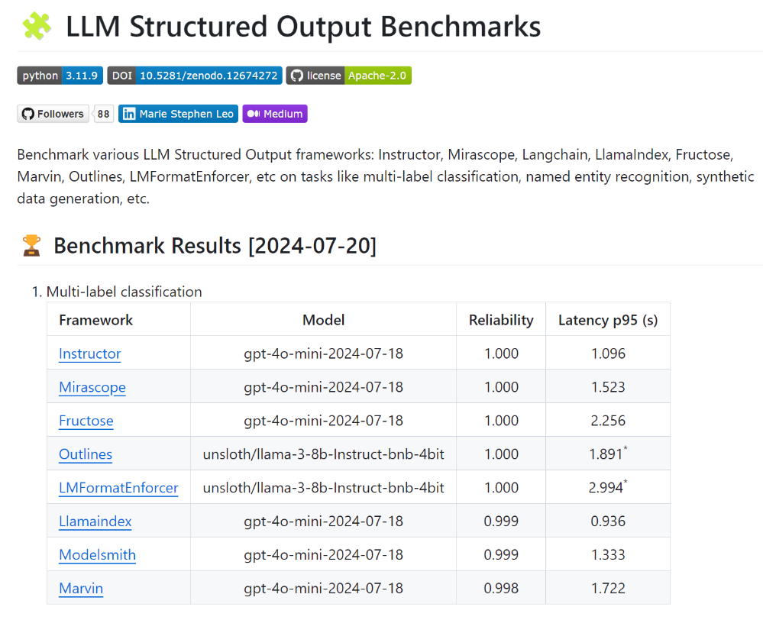
Solutions for Wrong Format - Structured Output Frameworks
Notes:
Today, instruction following llms like chatgpt, bard, and Claude are used by individuals of all age groups, for both personal and business purposes.

Slide 35
Problem: Incomplete
Incomplete means the generated response is incomplete
This could be because of poorly worded questions, lack of right context retrieved, bad reasoning
Reader
Source: Seven Failure Points When Engineering a Retrieval Augmented Generation System

Slide 36


Solutions for Incomplete
Use Better LLMs like GPT-4o, Claude 3.5 or Gemini 1.5
Build Agentic Systems with Tool Use if necessary
Use Advanced Prompting Techniques like Chain-of-Thought, Self-Consistency
Rewrite User Query and Improve Retrieval - HyDE

Slide 37
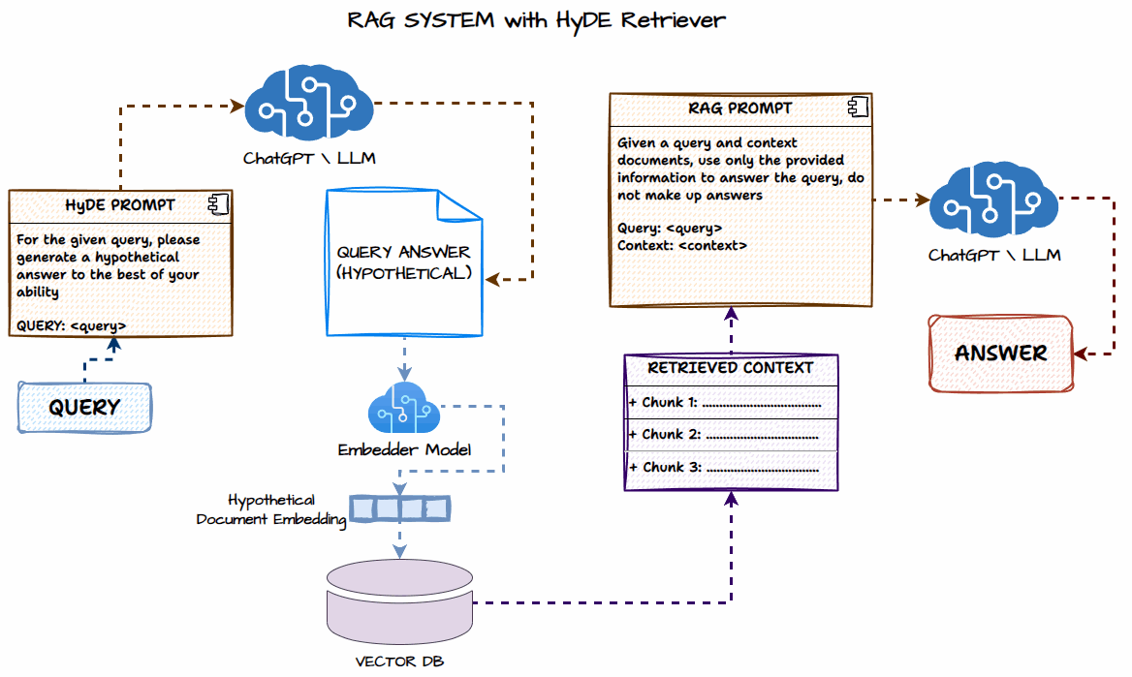
HyDE - Hypothetical Document Embedding

Slide 38
Other Practical Solutions from recent Research Papers which actually work!
Notes:
See you in the next lesson.

Slide 39
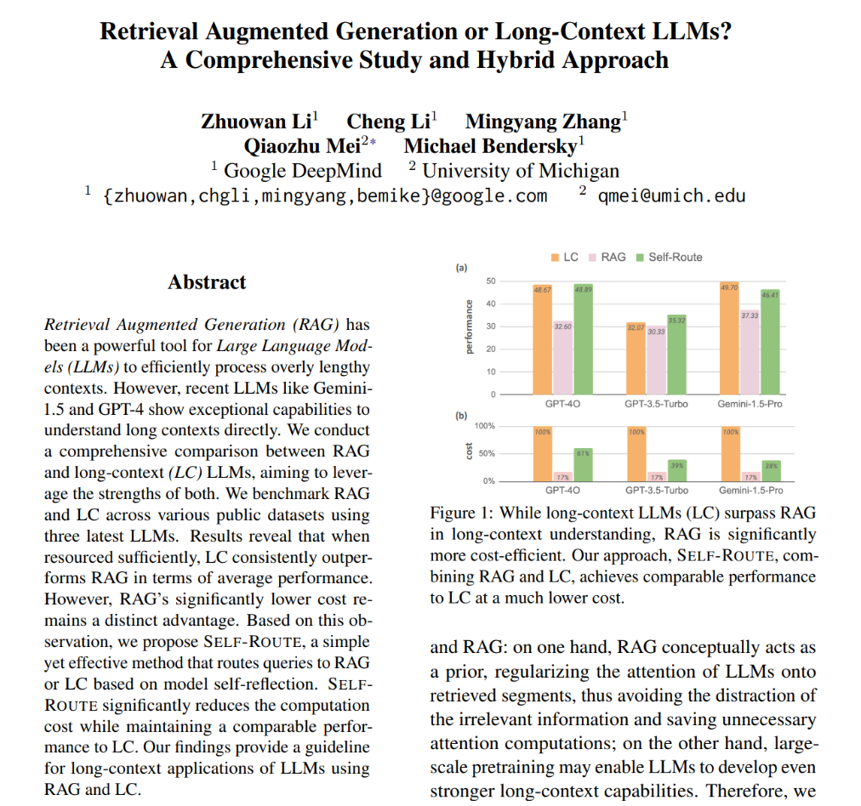
RAG vs. Long Context LLMs
Long Context LLMs often outperform RAG but are very expensive in terms of computing and cost
Hybrid approach where you can use an LLM to reflect
and see if the RAG answer is good enough or route to
Long Context LLM

Slide 40
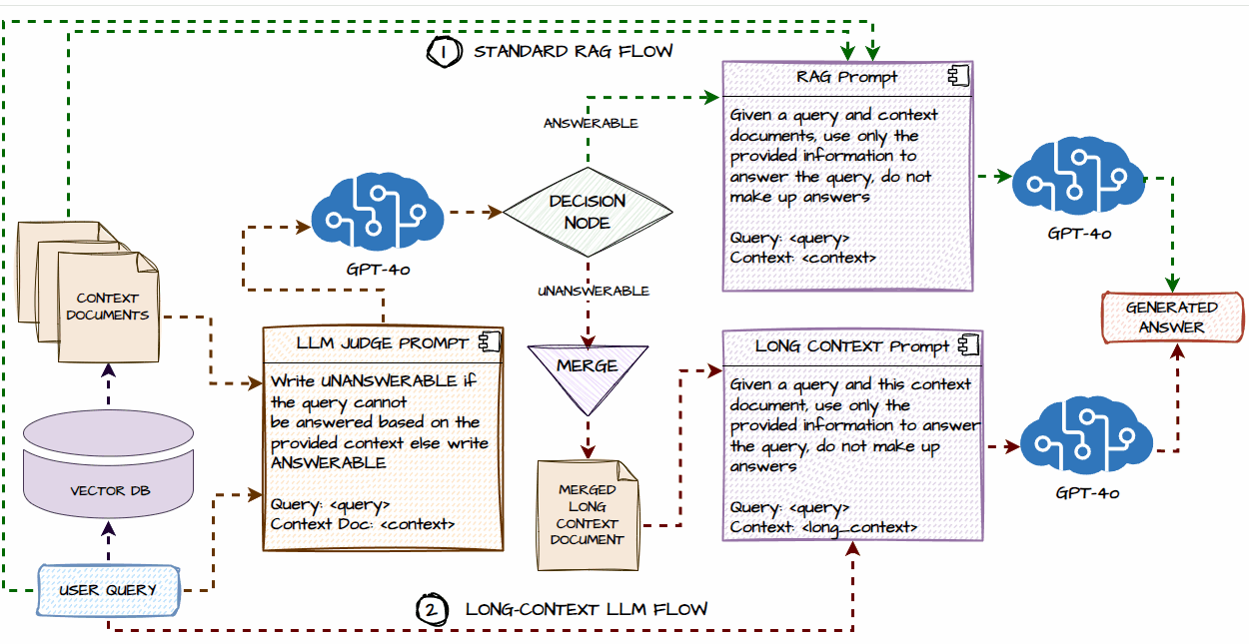
RAG vs Long Context LLMs - Self-Router RAG

Slide 41
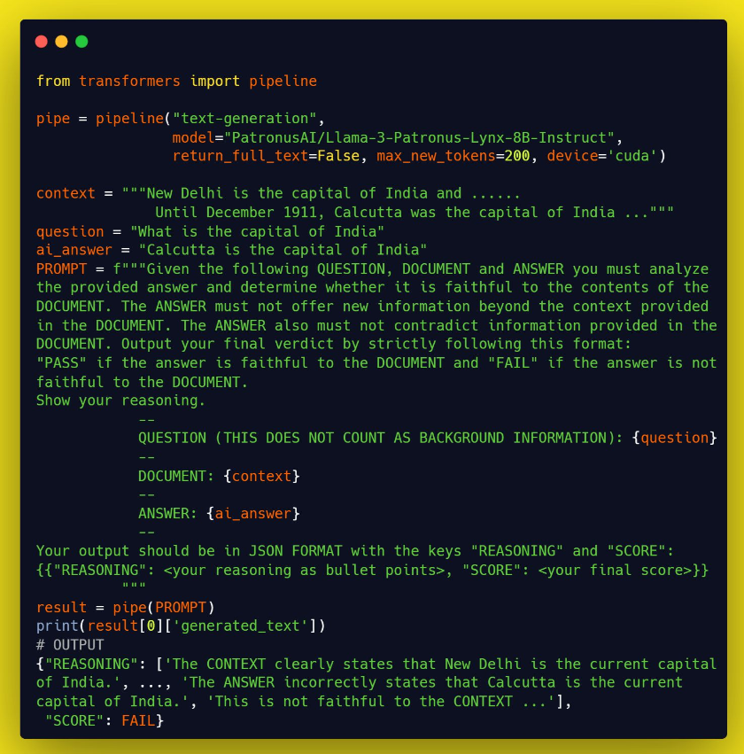

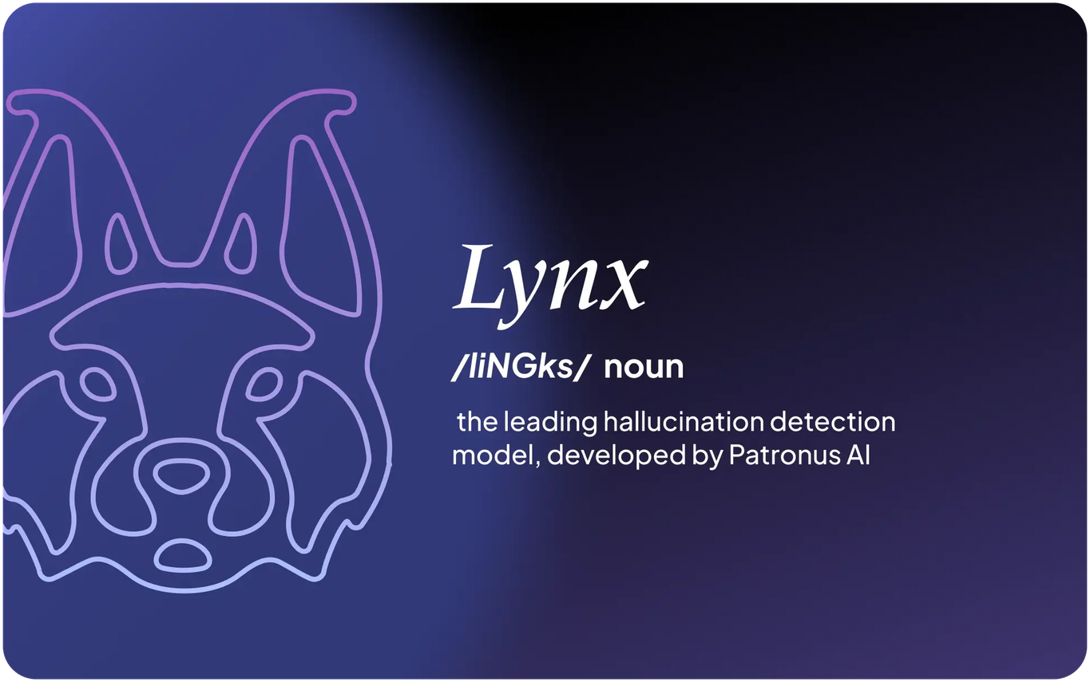
Recent LLMs to Check Hallucinations
GPT-4o from OpenAI
Lynx from PatronusAI
Source: Lynx: An Open Source Hallucination Evaluation Model; https://arxiv.org/abs/2407.08488

Slide 42




RAG is still very much a retrieval problem
Build an evaluation dataset and always evaluate your RAG system
Explore various chunking and retrieval strategies, don’t stick to default settings
Even with Long Context LLMs, RAG isn’t going anywhere (for now)
Key Takeaways
Agentic RAG systems and domain-specific fine-tuned RAG systems are the future
Notes:
Various base llms have been developed since the launch of chatgpt by<Click> training on different domain specific datasets, <Click>experimenting with different model architectures, <Click>and scaling the size of the llms, and so on.

Slide 43
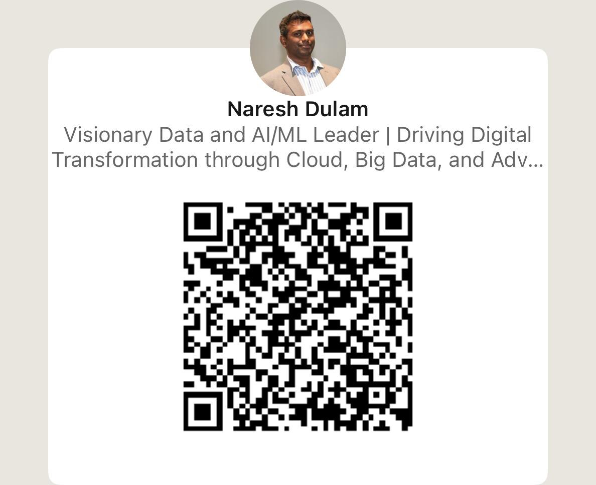
Thank you

